Slide 2
What’s important for you?
BUMAX® are known as the strongest stainless steel bolt on the market.
We are experts in materials. BUMAX ® is manufactured in Bufab:s plants in Sweden and we meet the requirements from high-end demanding customers when it comes to quality, corrosion resistance, high strength, traceability and heat resistance.
We can find the solutions for you and can meet the demands in demanding environments.
All BUMAX® products have full traceability and are made of highest quality steel from European manufactures.

Slide 3
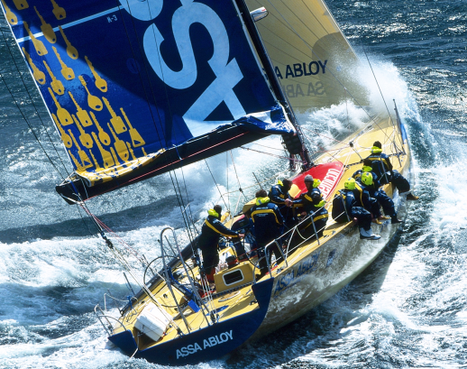
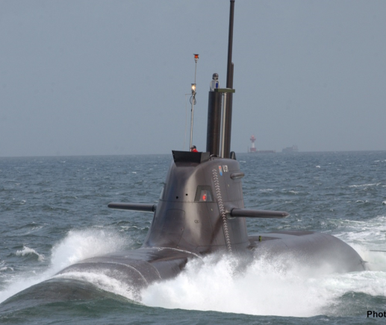
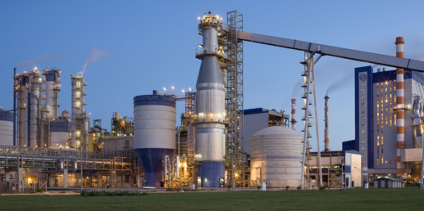
BUMAX starts where standard ends
Our customers can be found in oil and gas, pulp and paper, marine, petrochemical, energy and many other industries where standard fasteners simply cannot do the job.
Some of the products in the Bumax-family are completely unique products that cannot be found anywhere else on the market.
We work constantly to find the best fastener solutions with our customers and are eager to participate and contribute in an early stage in our customers development projects.
With our competence in fasteners and material we have many times developed ”impossible” nuts and bolts.
Your problem is our challenge!

Slide 4
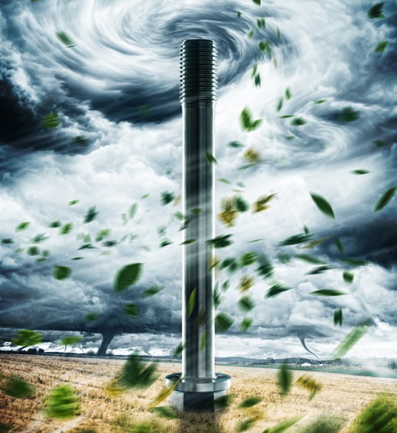
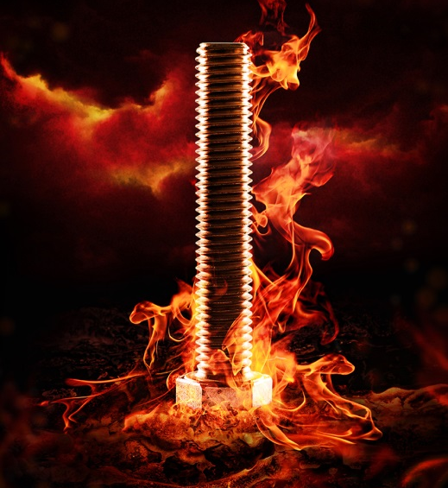
Reliable and resistant
Corrosion
We have the knowledge and products to give you a safe, reliable and long lasting fastener solution for every application and corrosive environment.
Temperature resistance
Bumax fasteners can be custom made and dependent on grade handle operating temperatures between 200 - 815 degrees Celsius.
Magnetic Permeability
Bumax fasteners can be supplied with extremely low permeability and are often used in advanced applications like fusion reactors or particle accelerators. Of course we can also supply fasteners with very high magnetic permeability and low coercive field strange.
Strength
We have delivered fasteners with a tensile strength exceeding strength class 15.9 for applications where down sizing, clamping force and strength are critical. In our product range we offer stainless fasteners ranging from strength class 8.8 to 15.9. Despite the high strength our unique materials offers a unique combination of ultra high strength and good ductility.

Slide 5
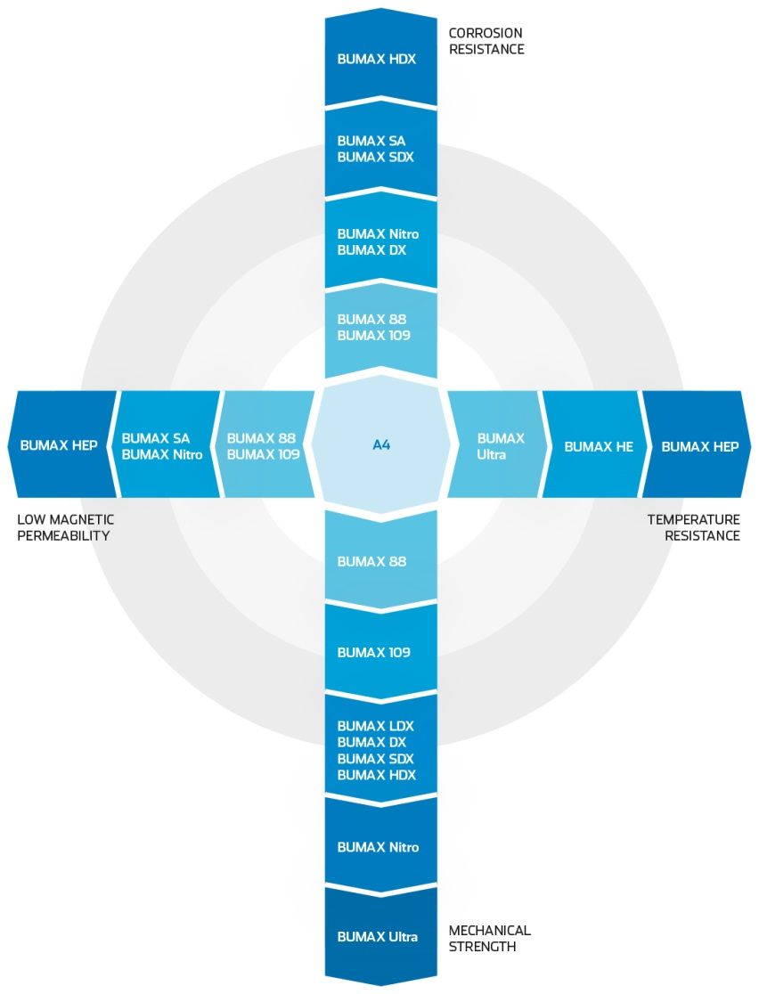
BUMAX grade selection cross
Stainless steel fasteners have properties which make them attractive choices for a wide range of applications. It is essential to consider the required properties such as corrosion resistance, temperature resistance, mechanical strength and magnetic permeability.

Slide 6
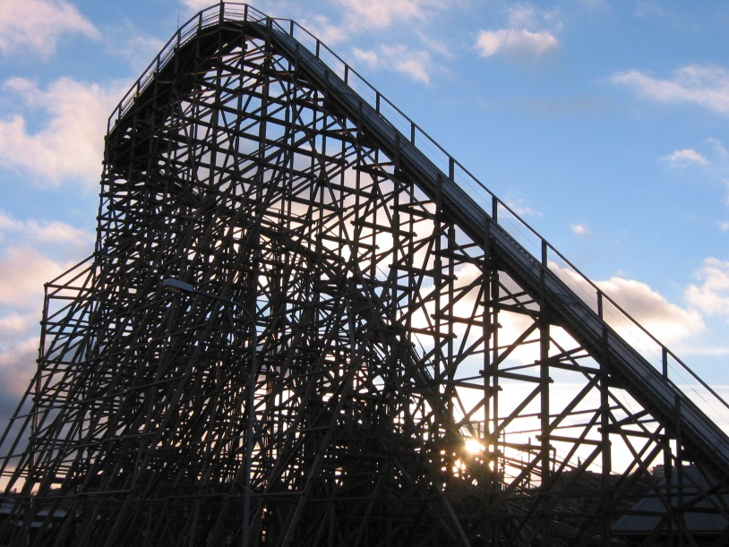
BALDER + BUMAX = TRUE
On the west coast of Sweden, in a town called Gothenburg you can find an amusement park called Liseberg. It has been voted by international experts to be “World’s best roller coaster made in wood”.
When Balder initial was built they used a mix of ISO 10642 in A4-70 and ISO Yellow zincplated 10642 in Carbon Steel 8.8/10.9. They experienced the following problems:
• The A4-70 fasteners could not handle the strain/load of the rollercoaster, they were too weak. The consequence was that the bolts were frequently breaking.
• The 8.8 bolts were corroding quickly and consequently breaking.
• The bolts, both A4-70/8.8 were lasting 1-2 years in the application before they broke.
In 2009 Liseberg decided to change the fasteners that they experienced problems with and changed to BUMAX; and ISO 14581 with a less recessed torx. This was a very successful change and still today they have not experienced any broken or corroded bolts after now more than 4 years of usage.

Slide 7
SOLUTIONIST

